Slide 1

Stored Procedure
By Shubh Patel

Slide 2
Index:
What Is stored procedure?
Types of stored procedures,
Functions of stored procedures,
Benefits of stored procedures,
Use of sp in db project.

Slide 3
Stored Procedure:
Stored Procedure is a group of statements executed before and has been stored in the database.
In other words it’s a prepared SQL statement which is stored in the database so that we can use it again in the future.

Slide 4
Types of Stored Procedure:
System:
They Start with a prefix ‘sp’.
They are included with SQL Server and physically stored in the database and appears in the sys schema of every system- and user-defined database.
User-defined:
They are declared by the users, and can be stored in every User-defined database.
Temporary:
They are type of User-defined procedure, they are also permanent as the other stored procedures, but they are stored in the tempdb.
Extended User-defined:
They enables creating external routines for other programming languages, they are an instance of sql server so they can loaded dynamically and run.

Slide 5
Functions of Stored Procedure:
Create
User can create Stored Procedures in two ways.
1. SSMS: Connect to a server-Object Explorer-Database-Expand any database-Expand Programmability-Stored Procedures-New Procedure
2. New Query:
USE database_name;
GO
CREATE PROCEDURE Procedure_Name
@Variable1 datatype, @Variable2 datatype
Modify:
User can modify Stored Procedures in two ways.
1. SSMS: Connect to a server-Object Explorer-Database-Expand any database-Expand Programmability-Stored Procedures-Procedure(Right Click)-Modify-Modify in query editor window.
2. New Query:
USE database_name;
GO
ALTER PROCEDURE Procedure_Name
@Variable1 datatype, @Variable2 datatype

Slide 6
Functions of Stored Procedure:
Delete
User can delete Stored Procedures in two ways.
1. SSMS: Connect to a server-Object Explorer-Database-Expand any database-Expand Programmability-Stored Procedures-Procedure Name(Right Click)-Delete after checking all the dependencies
2. New Query:
DROP PROCEDURE Procedure_Name
Execute
User can execute Stored Procedures in two ways.
1. SSMS: Connect to a server-Object Explorer-Database-Expand any database-Expand Programmability-Stored Procedures-Procedure(Right Click)-Execute
2. New Query:
USE database_name;
GO
EXEC/EXECUTE Procedure_Name @Variable1=‘ ’, @Variable2 = ‘ ‘
EXEC/EXECUTE Procedure_Name ‘ ’,’ ’(values for variables)

Slide 7
Benefits of Stored Procedure:
Reduced server/client network traffic
Stronger security
Reuse of code
Time saving
Easier maintenance
Improved performance

Slide 8
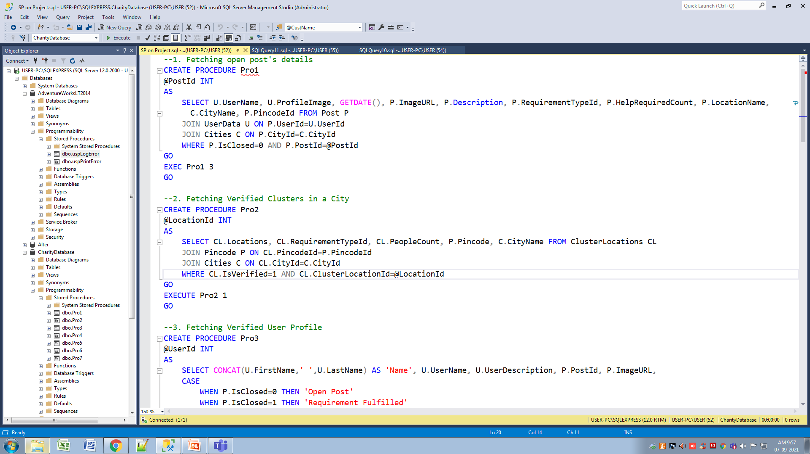
Use of Stored Procedure in DB Project:
Case-1: Fetching open post’s details.
Case-2: Fetching verified clusters in a city.

Slide 9
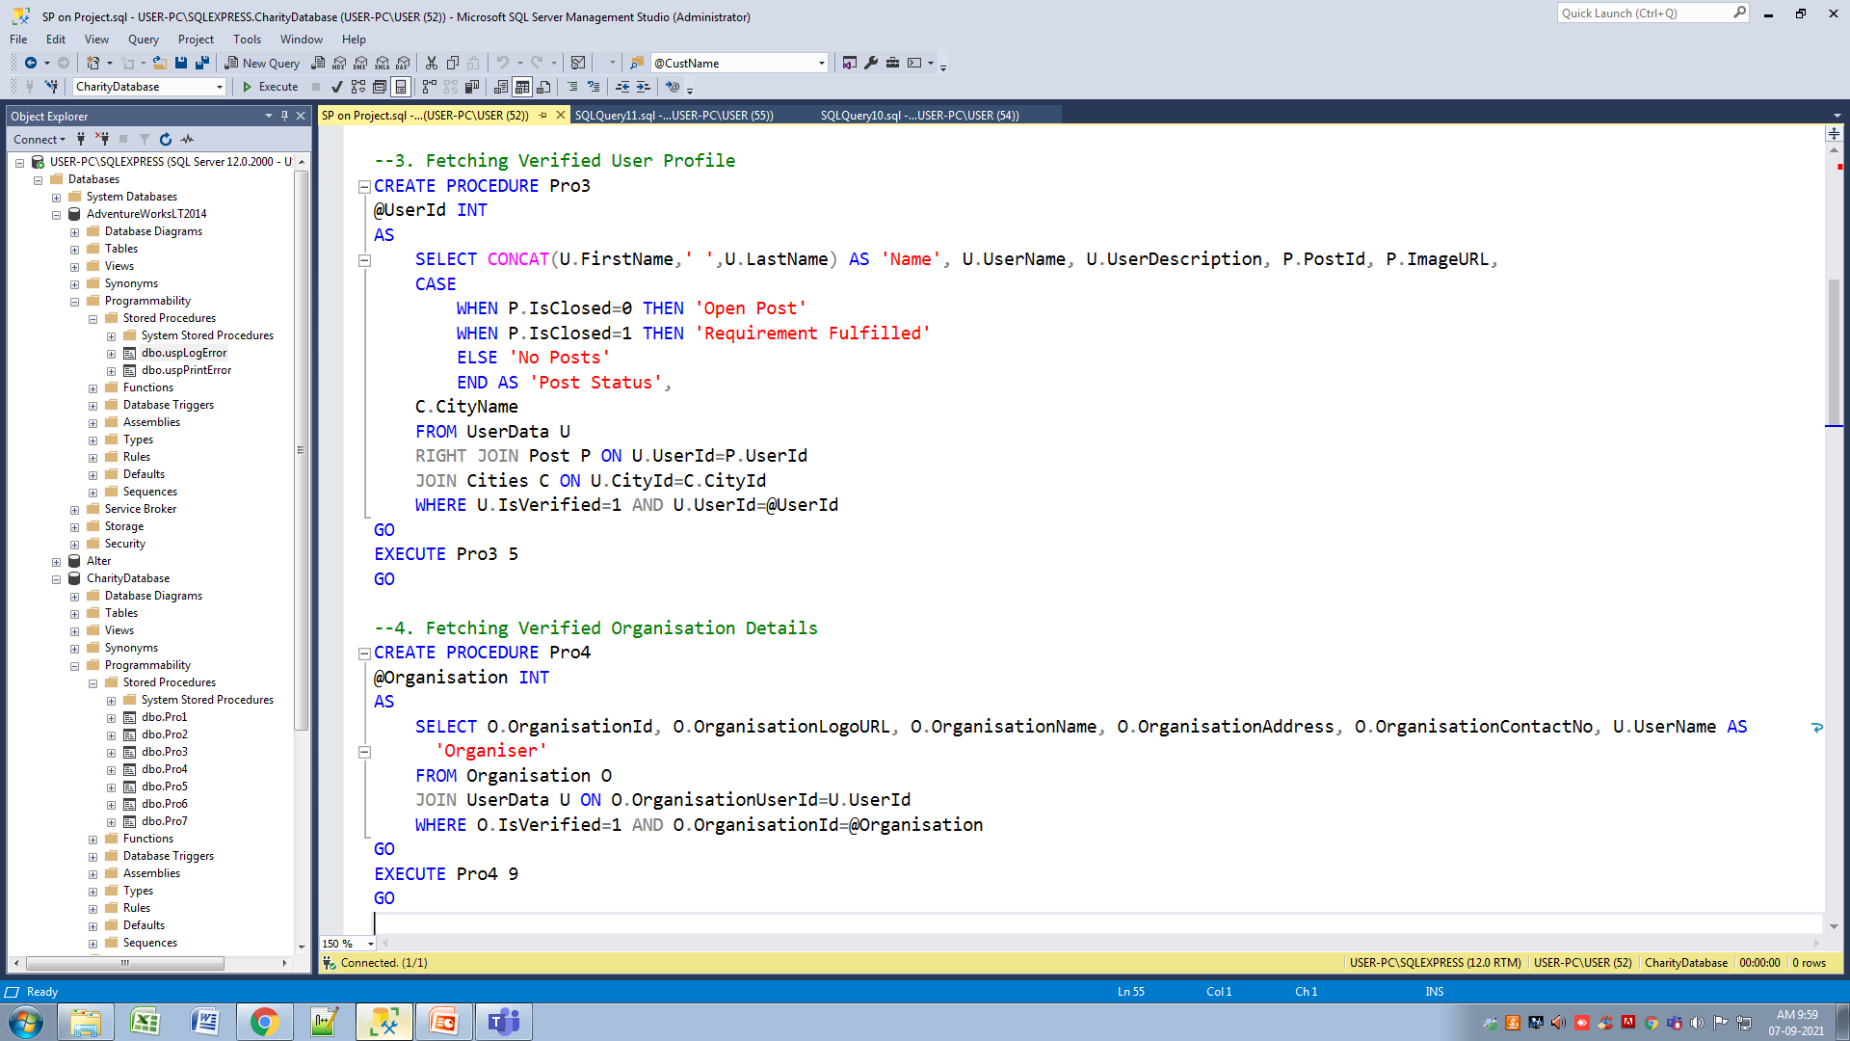
Use of Stored Procedure in DB Project:
Case-3: Fetching Verified User Profile.
Case-4: Fetching verified organisations.

Slide 10
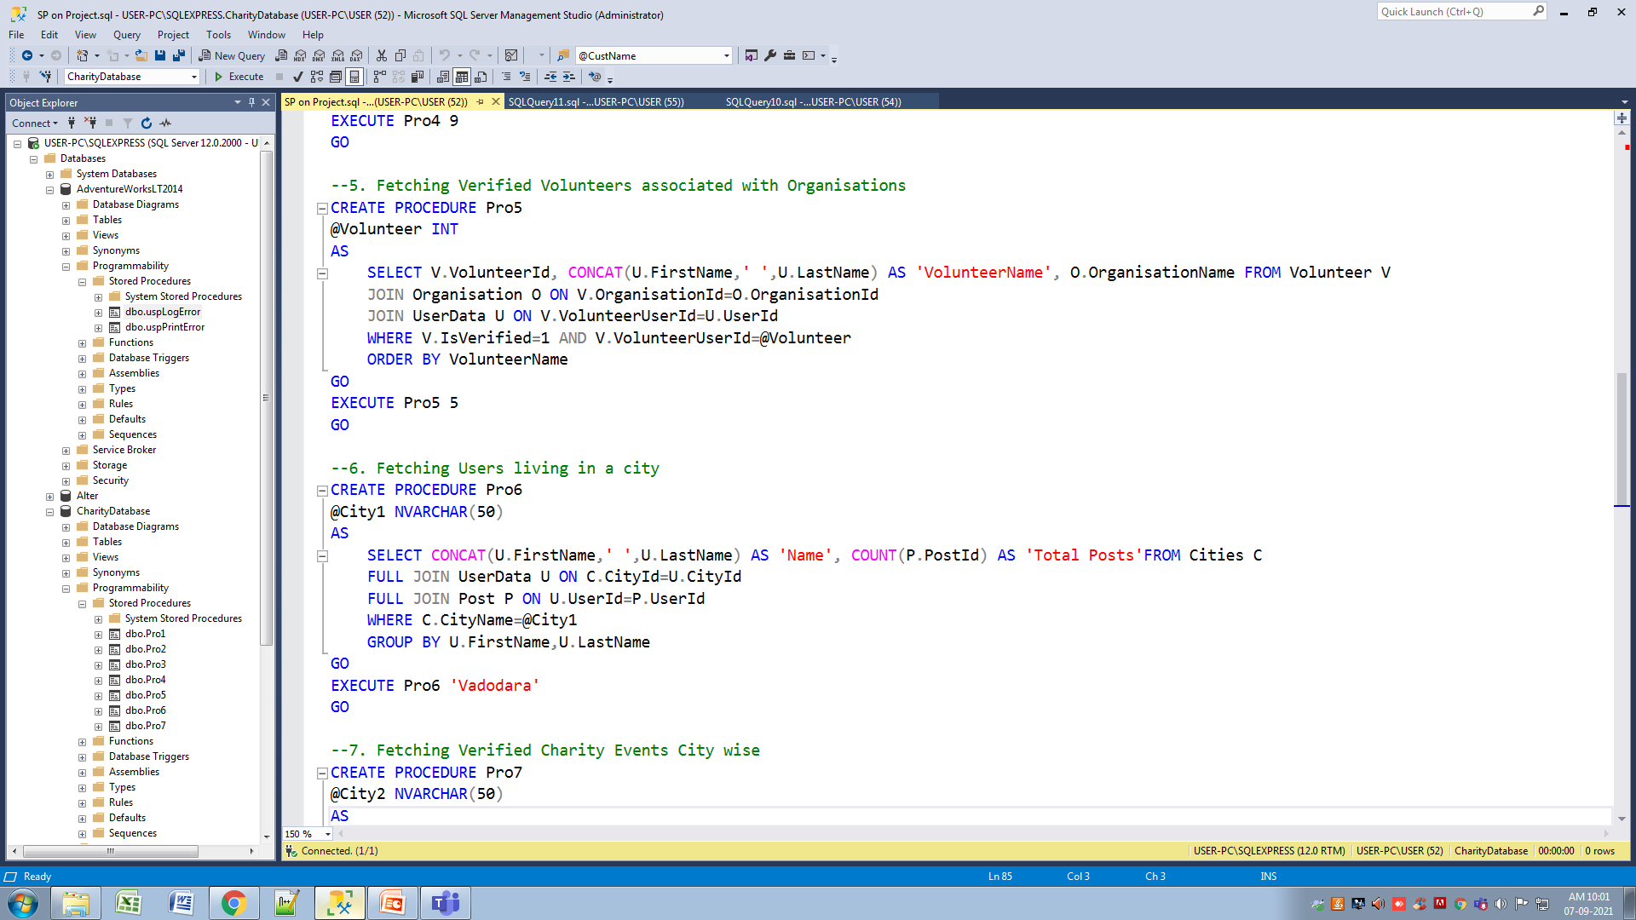
Use of Stored Procedure in DB Project:
Case-5: Fetching Verified Volunteers of Organisations.
Case-6: Fetching users living in a city.

Slide 11
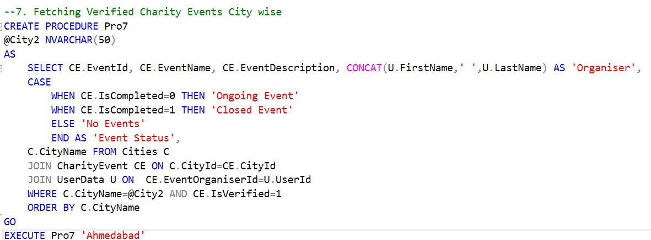
Use of Stored Procedure in DB Project:
Case-7: Fetching Verified Charity Events.

Slide 12
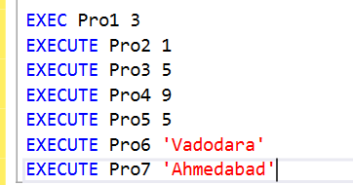
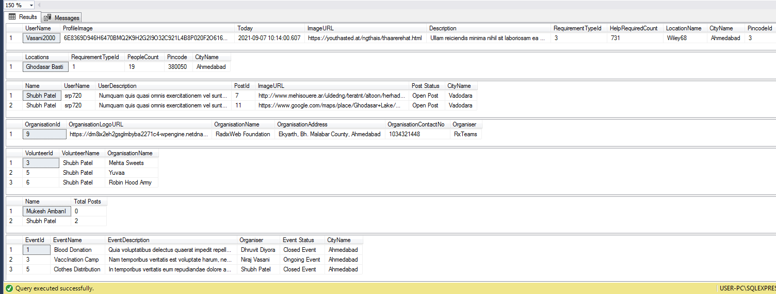
Use of Stored Procedure in DB Project:
Execution:
Output:

Slide 13
Thank you

